Slide 1

MNC Stock Market Price Prediction
Sai Sanjith Sivapuram
Devyani Deore

Slide 2
Appendix
Problem Statement
Project Flow Chart
Dataset Engineering and Pre-Processing
Exploratory Data Analysis
Machine Learning Models
Model Evaluations
Conclusion & Outcome

Slide 3

PROJECT FLOW CHART

Slide 4
Problem Statement
Stock market data is very important and has a huge impact on the industry.
Many people rely on stock trading for their daily lifestyle.
The ability to predict the price of a stock helps individuals make informed decisions increasing their probability to make profits.
How do we make accurate predictions?
Project Aim: This project aims to utilize an MNC stock dataset and execute the best Machine Learning algorithms/models to find the one that gives the closest close price predictions of the stock data.

Slide 5
Dataset Engineering & Pre-Processing
The dataset has been retrieved from Kaggle.
The dataset contains IBM stock data with features like:
Date
Open Price
High
Low
Volume
Close Price.
The dataset has a total of 3020 data points.
The data ranges from the year 2006 to 2018.
The close price ranges from $71.74 to $215.8.
The dataset contains minimal null values in the Open Price and Low Price columns. Null values are handled by replacing them with their respective column mean volumes.
Contribution: Devyani Deore

Slide 6
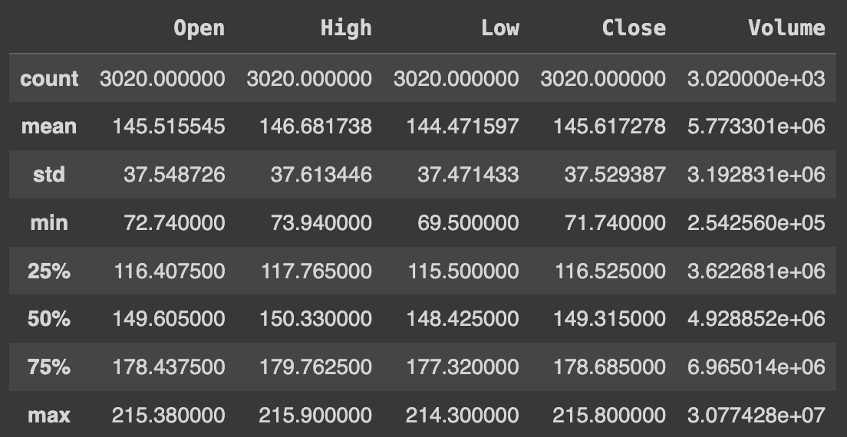
Statistical Summary of the Dataset
Contribution: Devyani Deore

Slide 7
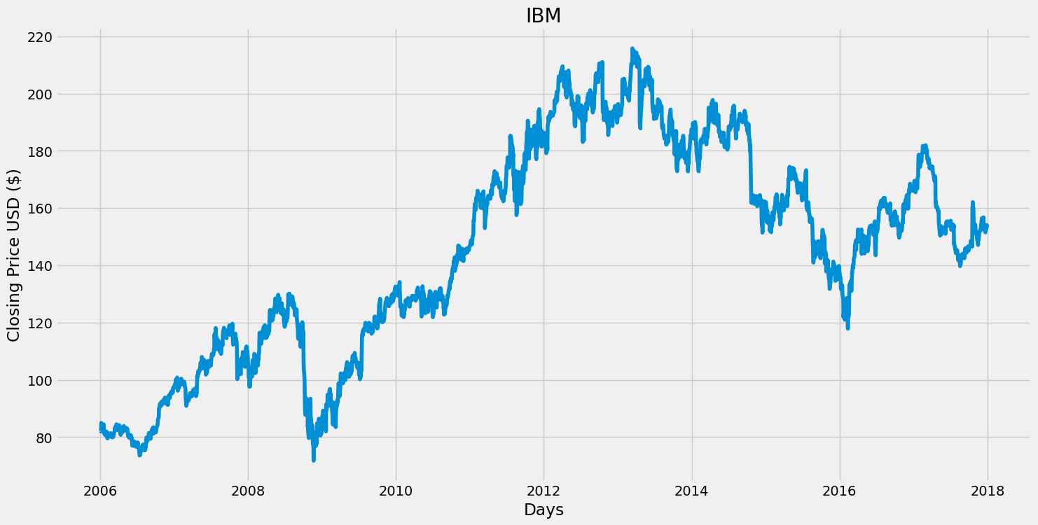
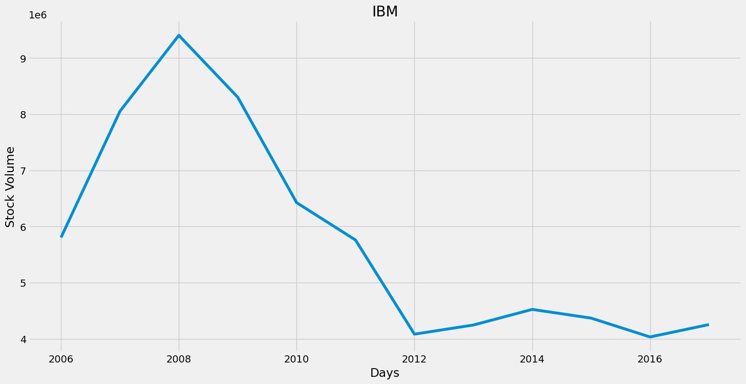
Exploratory Data Analysis
To understand the pattern and to retrieve meaningful insights from the data we have performed data visualization on certain necessary features of the dataset.
Line Plot b/w Date and Close Price
Line Plot b/w Date and Average Volume
Contribution: Sai Sanjith Sivapuram

Slide 8
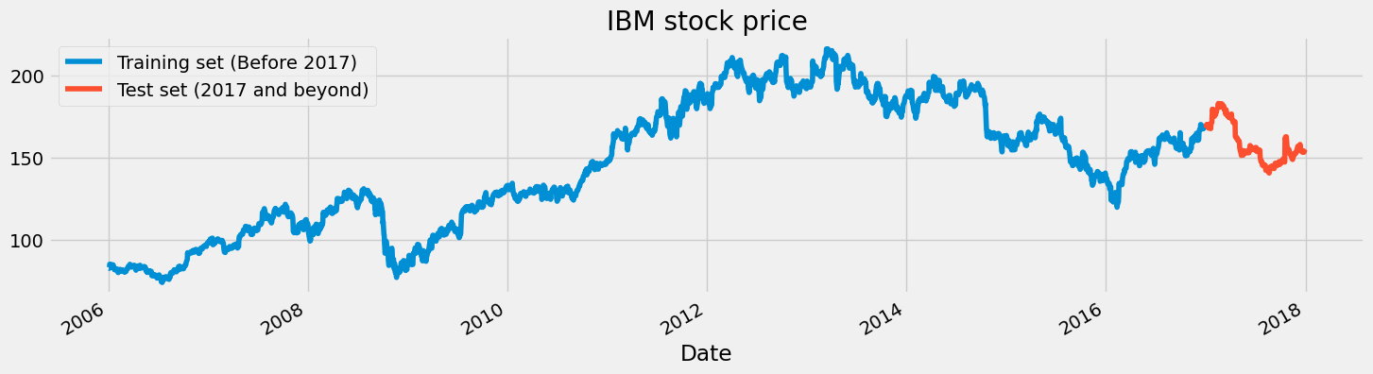
Exploratory Data Analysis
Contribution: Sai Sanjith Sivapuram

Slide 9
Machine Learning Models
For this dataset, we have decided to execute 3 different models known we for good performance on time-series data
The following are the models:
Random Forest Regressor
Long Short-Term Memory (LSTM)
Autoregressive Integrated Moving Average (ARIMA)
We have considered using the RMSE error metric evaluator to decide the best models out of the above to predict future stock prices.
Contribution: Devyani Deore & Sai Sanjith Sivapuram

Slide 10
Random Forest Regressor
Random forest models build on multiple decision trees and enable us to retrieve more accurate forecasts from the data.
This helps us to get more combinations enabling more information gain from the data.
These models help us to understand the non-linear relations in the data.
We have used around 200 estimators defining the number of decision tree combinations used by the model for the data and a random state of 40 (trial and error).
Contribution: Devyani Deore

Slide 11
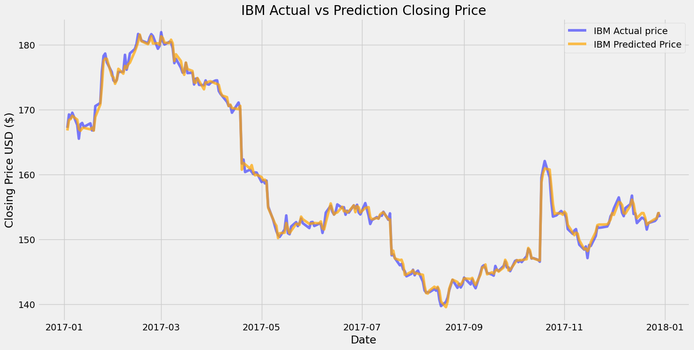
Random Forest Regressor Evaluations
RMSE obtained by the model is 0.63
Contribution: Devyani Deore

Slide 12
Long Short-Term Memory (LSTM)
LSTM models are based on RNN (recurrent neural networks) and work well with time series data.
The main advantage of LSTM is its ability to hold long-term dependencies on the data which is crucial for our data as we have data of around 5 years and models like LSTM take the whole data under consideration.
These models are known to handle non-linear relationships well.
We have defined an LSTM architecture using the Keras library. The model we have defined contains 4 LSTM layers with the ability to pass the outputs with the timestamps to the next layer in the architecture with 50 epochs and batch size of 32.
For evaluation criteria, we have used RMSprop optimizer and mean squared error as the loss function to retrieve the scores obtained by the model.
Contribution: Devyani Deore & Sai Sanjith Sivapuram

Slide 13
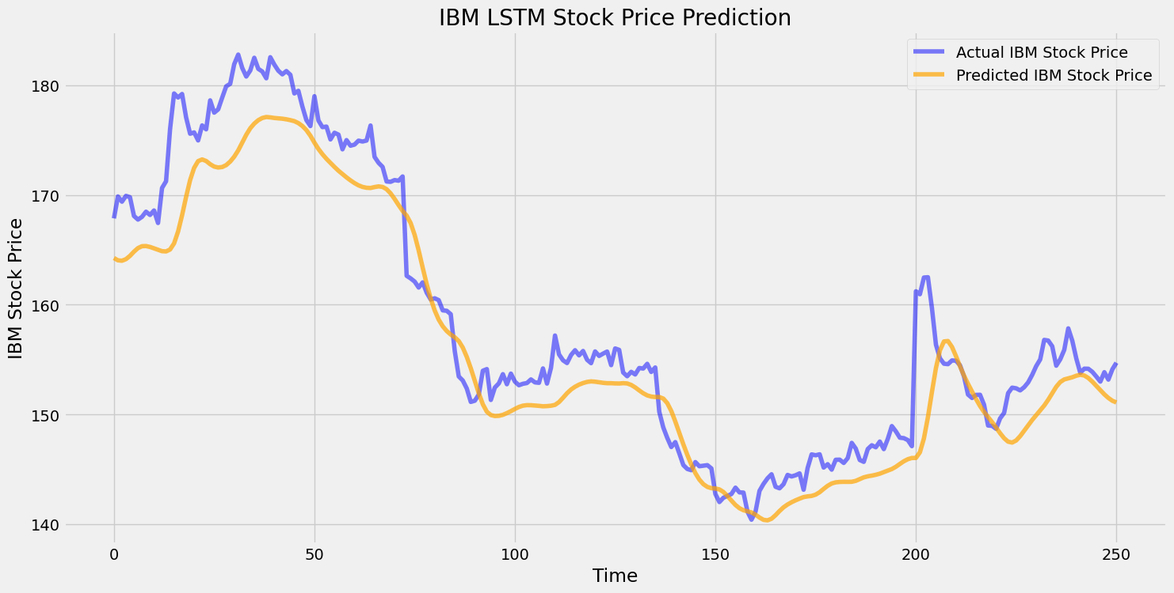
Long Short-Term Memory (LSTM) Evaluations
RMSE obtained by the model is 3.960
Contribution: Devyani Deore & Sai Sanjith Sivapuram

Slide 14
Autoregressive Integrated Moving Average (ARIMA)
ARIMA is well known for working with time series data (preferably stationary data).
As our dataset contains the history of the stock prices for different companies hence the data is stationary and suitable for models like ARIMA to perform well.
We installed the required libraries and performed certain pre-requisite checks on the dataset such as stationarity, rolling mean, and rolling standard deviation on the target variable.
We have observed that the rolling mean and standard deviation are not stationary and have changed the data to become stationary by removing trends in the dataset and creating a train test split for the data.
Contribution: Sai Sanjith Sivapuram

Slide 15
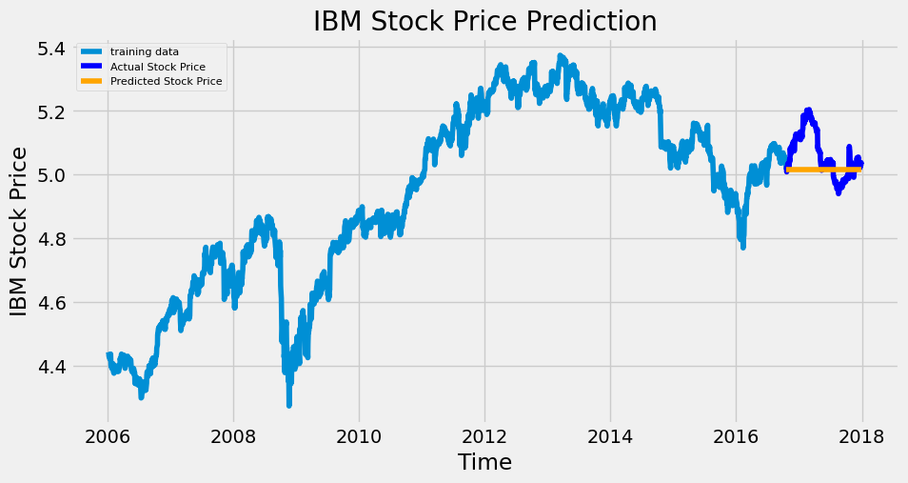
Autoregressive Integrated Moving Average (ARIMA)
RMSE obtained by the model is 0.083
Contribution: Sai Sanjith Sivapuram

Slide 16
Conclusion & Outcome
To evaluate the best model, we have chosen to use the RMSE error metric, and the one with the lowest score was found to be the ARIMA model with the lowest score of 0.083.
Based on the observations we can conclude that ARIMA has performed the best among the other models in the dataset.
During the whole project execution, we as a team learned about the ARIMA and LSTM models and how to implement them. Also, we had a good understanding of how to deal with time series data mainly we got to know about the importance of dates and their essence in train test splitting.

Slide 17
THANK YOU

